Slide 1
AC CURRENT DETECTOR
MINOR PROJECT
Presented by:- BATCH-08
SRI LAKSHMI -181FA05093
RIYAN -181FA05161
ALI SHAH -181FA05176

Slide 2
OBJECTIVE:-
TO DESIGN A VERY SIMPLE AC CURRENT DETECTOR CIRCUIT USING 555 TIMER
AND ANALYSE THE CIRCUIT.

Slide 3
COMPONENTS:-
IC 555 TIMER
4.7uF CAPACITOR
220Ω and 10K RESISTORS
BUZZER
LED
ANTENNA
BATTERY

Slide 4
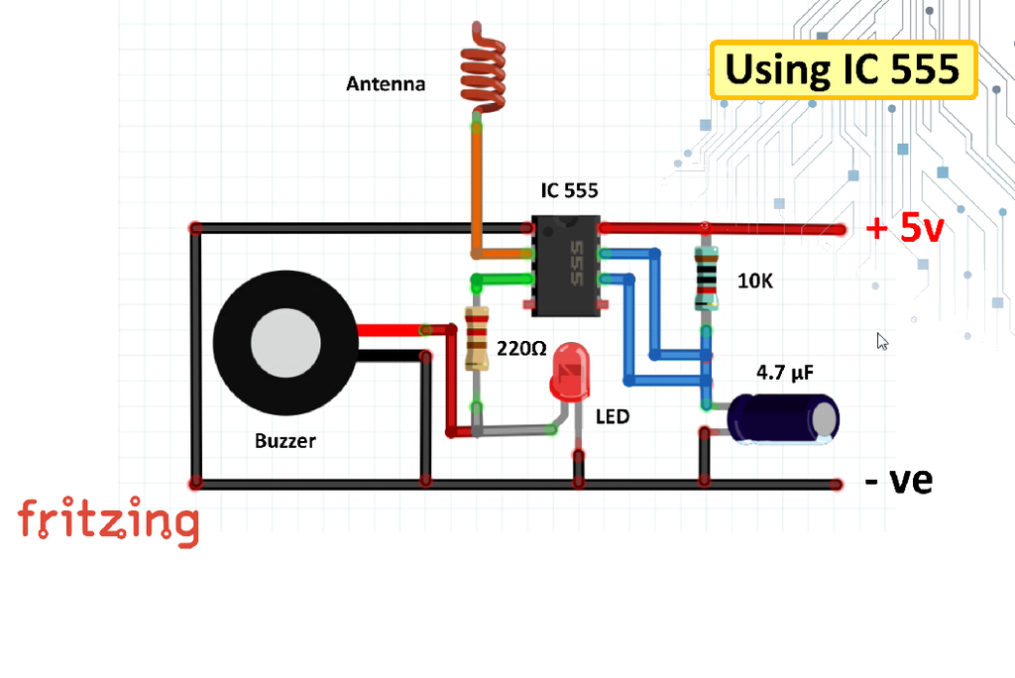
CIRCUIT DIAGRAM

Slide 5
THEORY:-
555 timer is the most commonly used IC in electronics projects because it’s small, inexpensive, and very useful. This circuit is very simple. When the voltage on Pin-2 falls below 1⁄3 of VCC the Output on Pin-3 goes HIGH and the LED lights up. As long as this pin continues to be kept at a low voltage, the OUT pin will remain HIGH. So, when the antenna detects an alternating input the output goes HIGH and LOW and the LED flashes accordingly.

Slide 6
WORKING
Connect Pin-1 to ground. Pin-2 to the antenna. Pin-3 to the LED and the buzzer. Pin-6 to the +ve leg of the capacitor and Pin-7 to one end of the 10K resistor. Then Pin-6 or the Threshold pin and Pin-7 or the Discharge pin need to be connected to each other. Pin-8 and the other end of the 10K resistor connects to the +ve rail of the circuit board, and finally connect all the -ve legs to the negative rail of the circuit board.

Slide 7
Alright, now lets do a quick test.
This circuit actually works on the principle of electromagnetic induction.
A magnetic field is produced around a current carrying conductor and if current through the conductor is alternating current (AC), the magnetic field produced varies periodically.
When we place an antenna near an AC energized object, a small current gets induced into the antenna due to electromagnetic induction.
By amplifying this current we can light up a LED or a buzzer circuit, indicating that AC voltage is present.

Slide 8
As we bring a live wire close to the antenna the buzzer and the LED starts buzzing and flashing.
If I put my hand around the antenna it has no effect on the circuit. Which makes this setup more reliable as I am not getting any false reading.

Slide 9
PROS:-
circuit is small in size.
easy to construct.
cost effective .
detects the breakage of connection.
prevents shocks without in contact.

Slide 10
CONS:-
Cannot be used to detect dc current in a conductor.
It cannot measure the amount of current and will only indicate the presence of current.
Circuit can not be used to test the current inside the sockets.

Slide 11
APPLICATIONS:-
ELECTRICAL WIRING.
PROFESSIONAL TECNITIONS.
LAMP CORDS.
ELECTRICIANS.

Slide 12
REFERENCES:-
https://www.instructables.com/Contactless-Voltage-Detector/
http://www.circuitdiagram.org/non-contact-ac-voltage-detector.html#:~:text=Non%20Contact%20AC%20Voltage%20Detector,contact%20AC%20voltage%20detector%20circuit.&text=The%202N3819%20transistor%20is%20working,6%20to%2012%20volt%20DC.

Slide 13


